Slide 1


Exploring Adjective Ordering Preferences via Artificial Language Learning
Michael Hahn (Stanford)
Richard Futrell (MIT)
Judith Degen (Stanford)

Slide 2
Adjective Ordering
the big blue table
VS
the blue big table
the beautiful old house
the old beautiful house
VS
the delicious boiling curry
VS
the boiling delicious curry

Slide 3
Adjective Ordering
the big blue table
VS
the blue big table
the beautiful old house
the old beautiful house
VS
the delicious boiling curry
VS
the boiling delicious curry
Quite stable across languages. Inverted when adjectives are postnominal.

Slide 4
Adjective Ordering
the big blue table
VS
the blue big table
the beautiful old house
VS
the old beautiful house
the delicious boiling curry
VS
the boiling delicious curry
Various generalizations have been offered
Inherentness
Specificity
Absoluteness
Concept-Formability
Subjectivity
Inherentness (Whorf 1945)
Specificity (Sweet 1898, Ziff 1960)
Absoluteness (Sproat & Shih 1991)
Concept-Formability (Svenonius 2008)
Subjectivity (Hetzron 1978)

Slide 5
Adjective Ordering
the big blue table
VS
the blue big table
the beautiful old house
VS
the old beautiful house
the delicious boiling curry
VS
the boiling delicious curry
Various generalizations have been offered
Inherentness (Whorf 1945)
Specificity (Sweet 1898, Ziff 1960)
Absoluteness (Sproat & Shih 1991)
Concept-Formability (Svenonius 2008)
Subjectivity (Hetzron 1978)
Scontras et al. (2017):
Subjectivity captures all of these

Slide 6
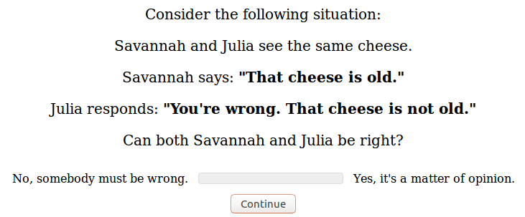
Diagnosing Subjectivity: Faultless Disagreement
From Scontras et al. (2017)

Slide 7
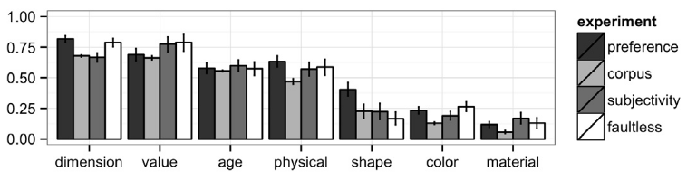
big
good
old
smooth
round
blue
metal
From Scontras et al. (2017)

Slide 8
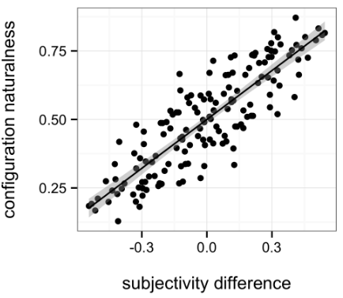
The more subjective an adjective, the farther from the noun it occurs.
From Scontras et al. (2017)

Slide 9
Research Question
What underlies this subjectivity effect?
Option 1:
Option 2:
Speakers productively apply a semantic generalization to adjectives
Speakers order adjectives based on the statistics of the input, which happens to correlate with subjectivity

Slide 10
Research Question
What underlies this subjectivity effect?
Option 1:
Option 2:
Speakers productively apply a semantic generalization to adjectives
Speakers order adjectives based on the statistics of the input, which happens to correlate with subjectivity

Slide 11
Research Question
What underlies this subjectivity effect?
Option 1:
Option 2:
Speakers productively apply a semantic generalization to adjectives
Speakers order adjectives based on the statistics of the input, which happens to correlate with subjectivity

Slide 12
Artificial Language Learning Study
Subjects learn two Alien adjectives whose meanings differ in subjectivity
indicate preference among the possible orderings of Alien + English adjectives

Slide 13
Artificial Language Learning Study
Subjects learn two Alien adjectives whose meanings differ in subjectivity
indicate preference among the possible orderings of Alien + English adjectives
Predictions
If speakers apply productive generalization based on subjectivity, will prefer more subjective Alien adjective earlier
If they order adjectives based on statistics of input, expect no ordering preference for these novel adjectives

Slide 14









Slide 15




Objective Adjective

Slide 16
Subjective Adjective

Slide 17
From Scontras et al. (2017)

Slide 18
big, small
Blue, green, red
From Scontras et al. (2017)

Slide 19
Choice of Alien Adjectives
For each subject, two Alien adjectives sampled from 60 noncewords (Rastle et al., 2002)
randomly assigned to the two meanings
Objective adjective refers to saucers for half of the subjects and to rockets for others

Slide 20
Experiment
Acquisition
1 | Exposure | 16 trials | Introduce Adjectives
2 | Comprehension | 48 trials | Make sure subjects understand meanings
3 | Production | 55 trials | Make subjects use adjectives
Order Ratings
 | Ratings | 25 trials | Probe Order Ratings
Subjectivity Ratings
 | Questionnaire |  | Subjectivity & Faultless Disagreement

Slide 21
Experiment
Acquisition
1 | Exposure | 16 trials | Introduce Adjectives
2 | Comprehension | 48 trials | Make sure subjects understand meanings
3 | Production | 55 trials | Make subjects use adjectives
Order Ratings
 | Ratings | 25 trials | Probe Order Ratings
Subjectivity Ratings
 | Questionnaire |  | Subjectivity & Faultless Disagreement

Slide 22
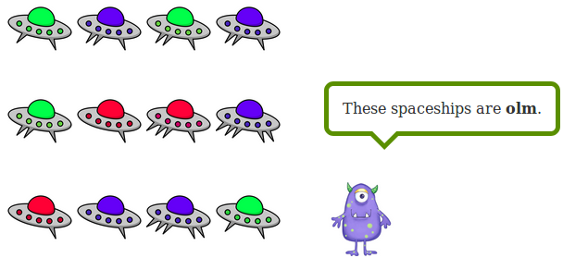
Exposure Block
Exposure
Comprehension
Production
Order Ratings
Subjectivity Ratings

Slide 23
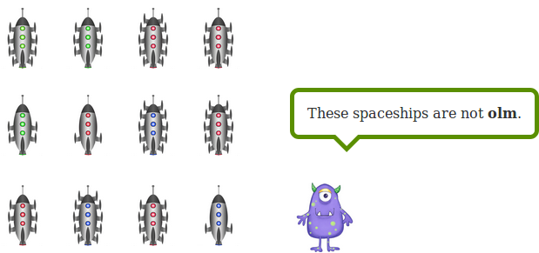
Exposure Block
Exposure
Comprehension
Production
Order Ratings
Subjectivity Ratings

Slide 24
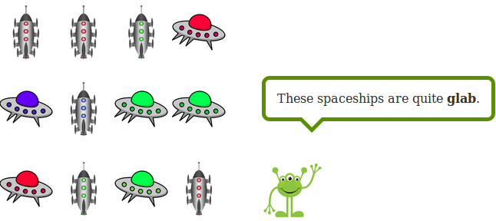
Exposure Block
Exposure
Comprehension
Production
Order Ratings
Subjectivity Ratings

Slide 25
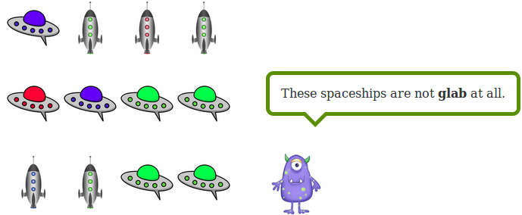
Exposure Block
Exposure
Comprehension
Production
Order Ratings
Subjectivity Ratings

Slide 26
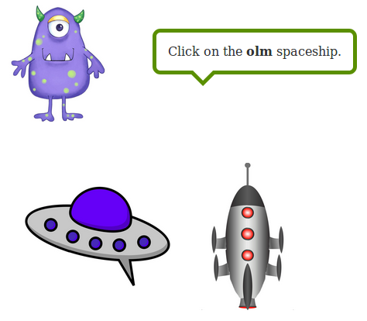
Comprehension Block
Exposure
Comprehension
Production
Order Ratings
Subjectivity Ratings

Slide 27
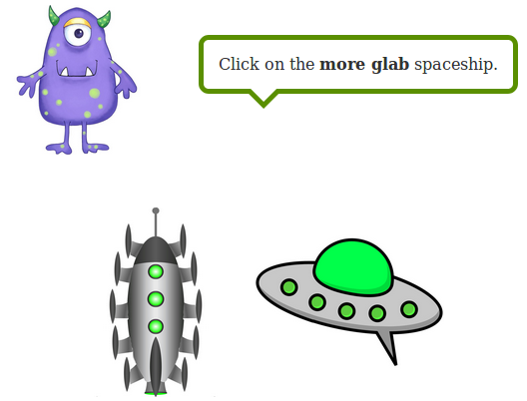
Comprehension Block
Exposure
Comprehension
Production
Order Ratings
Subjectivity Ratings

Slide 28
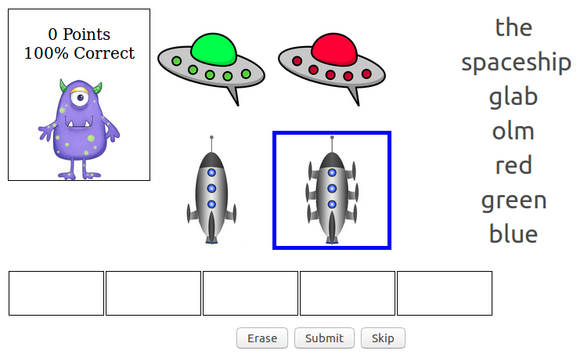
Production Block
Exposure
Comprehension
Production
Order Ratings
Subjectivity Ratings

Slide 29
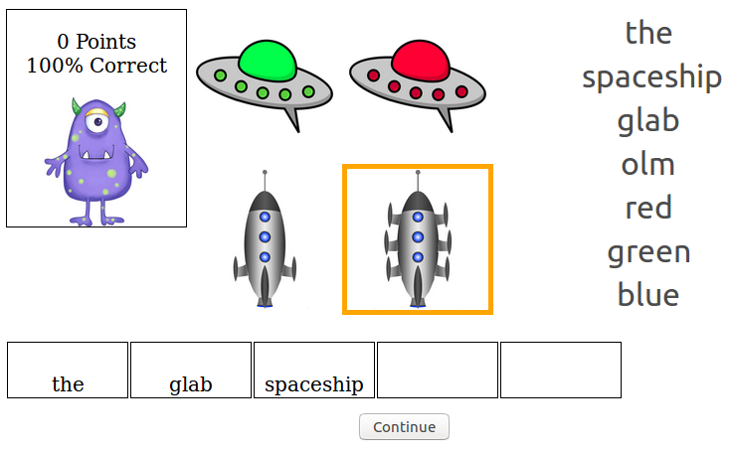
Production Block
Exposure
Comprehension
Production
Order Ratings
Subjectivity Ratings

Slide 30
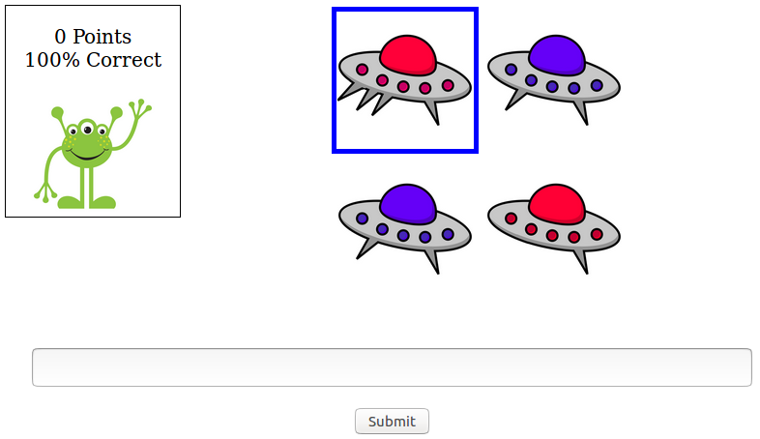
Production Block
Exposure
Comprehension
Production
Order Ratings
Subjectivity Ratings

Slide 31
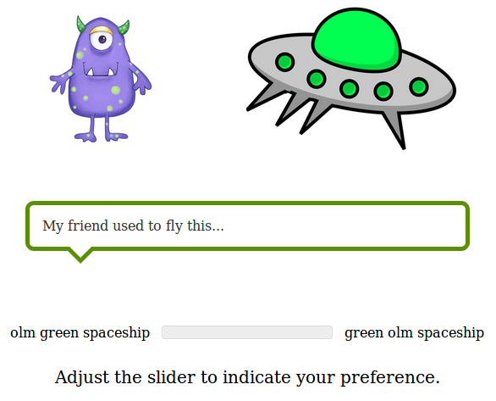
Ratings Block
Exposure
Comprehension
Production
Order Ratings
Subjectivity Ratings

Slide 32
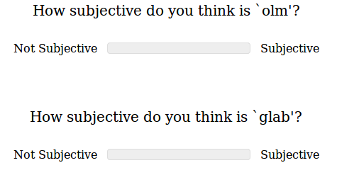
Subjectivity Ratings
Exposure
Comprehension
Production
Order Ratings
Subjectivity Ratings

Slide 33
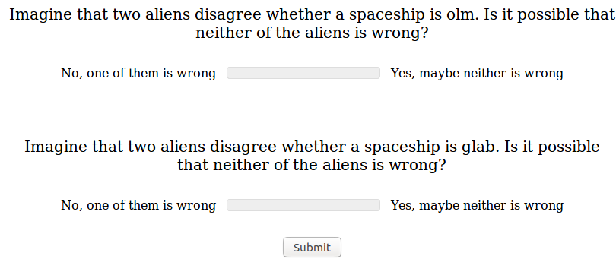
Faultless Disagreement Ratings
Exposure
Comprehension
Production
Order Ratings
Subjectivity Ratings

Slide 34
Experiment
36 participants from AMT
Participants with comprehension accuracy < 85 % (N = 5) excluded
Comprehension accuracy 97.0 %
Production task success rate 99.3 %

Slide 35
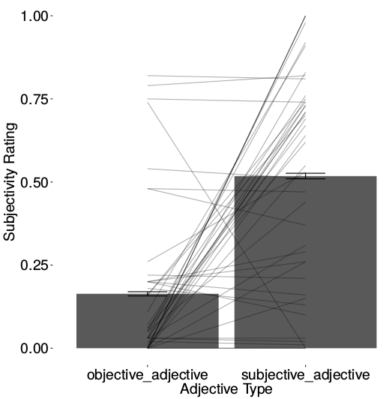
Assessing Manipulation Effect

Slide 36
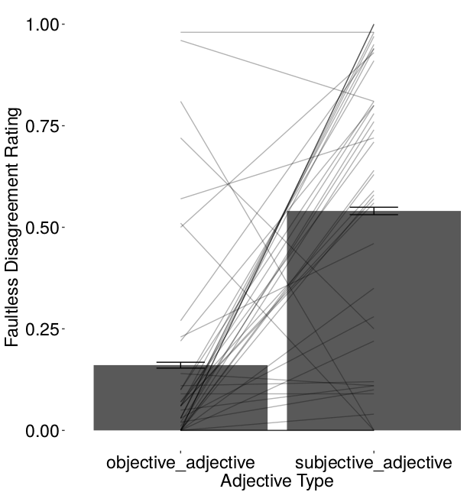
Assessing Manipulation Effect

Slide 37
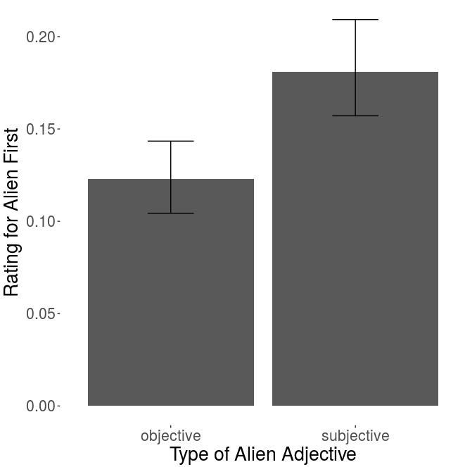
p < 0.01
the olm … spaceship
the glab … spaceship

Slide 38
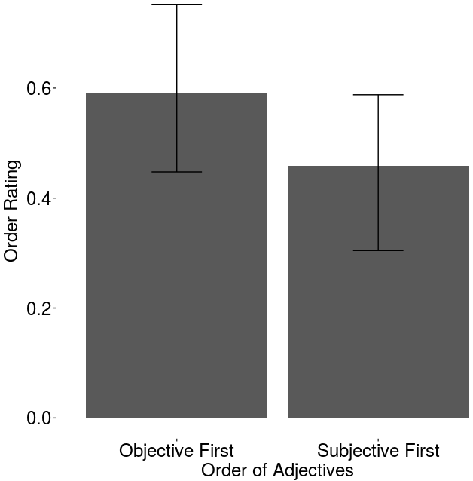
n.s.
Alien-Alien
the olm glab spaceship
the glab olm spaceship

Slide 39
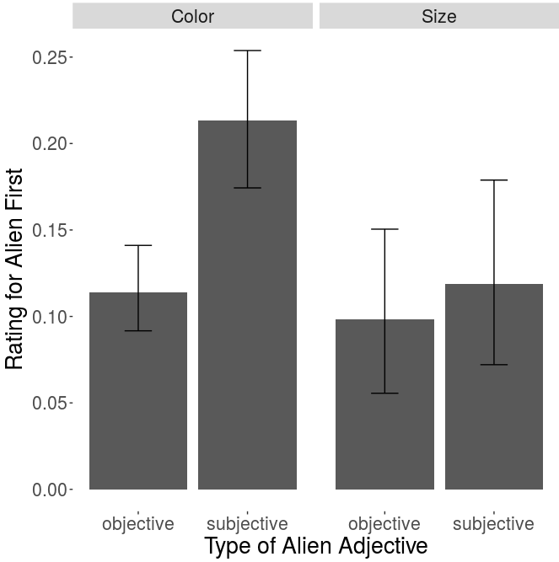
Alien-Color
p < 0.01
the olm green spaceship
the glab green spaceship

Slide 40

Alien-Size
n.s.
the olm big spaceship
the glab big spaceship

Slide 41
Experiment II
Question: Does this finding generalize?
Approach: Same experimental setup but reverse subjectivity
Subjective: `rocket-like’ / `saucer-like’
Objective: `has spikes’ / `doesn’t have spikes’

Slide 42













Objective Adjective

Slide 43




Subjective Adjective

Slide 44
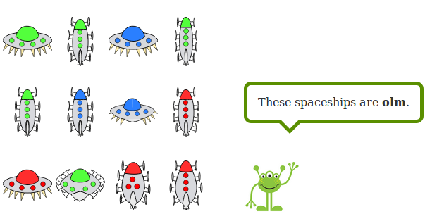
Exposure Block

Slide 45
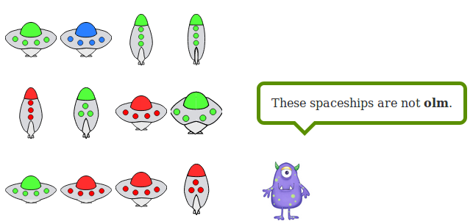
Exposure Block

Slide 46
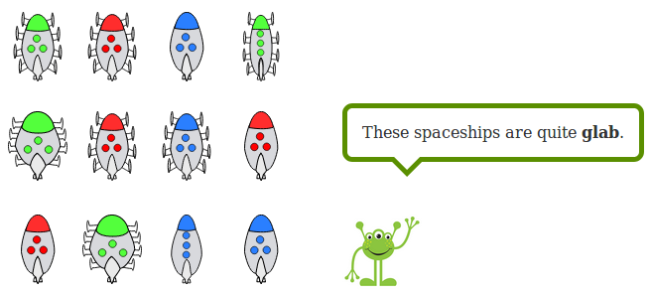
Exposure Block

Slide 47
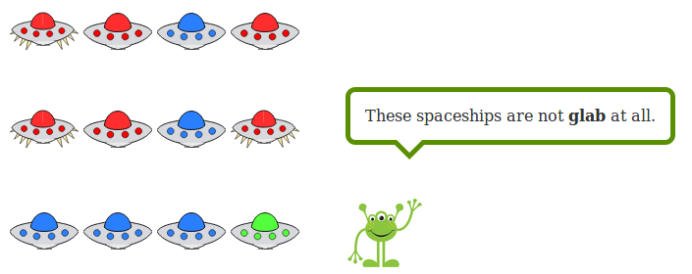
Exposure Block

Slide 48
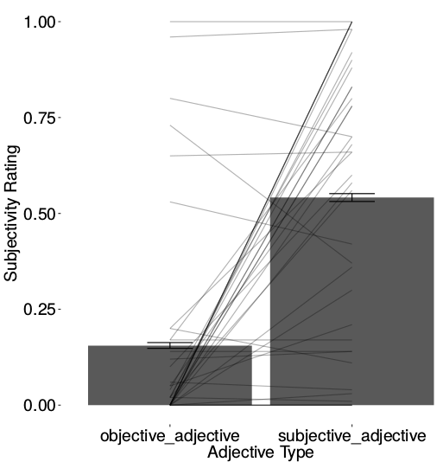
Assessing Manipulation Effect

Slide 49
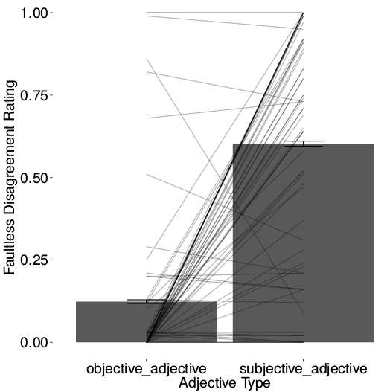
Assessing Manipulation Effect

Slide 50
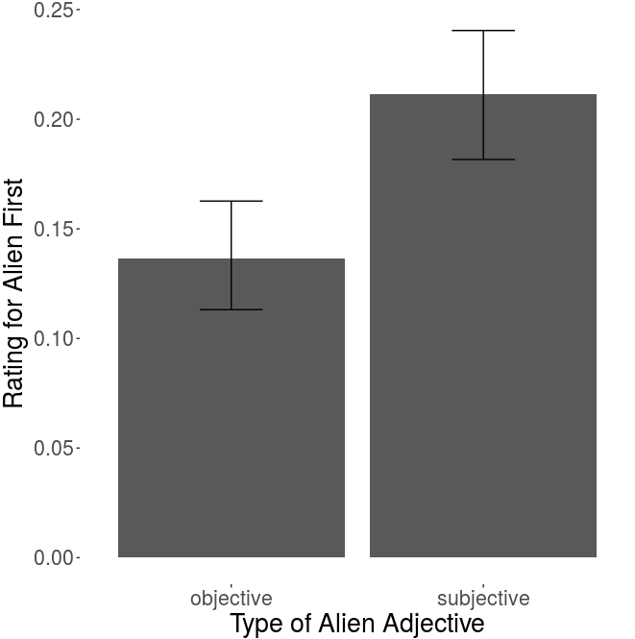
p < 0.01
the olm … spaceship
the glab … spaceship

Slide 51
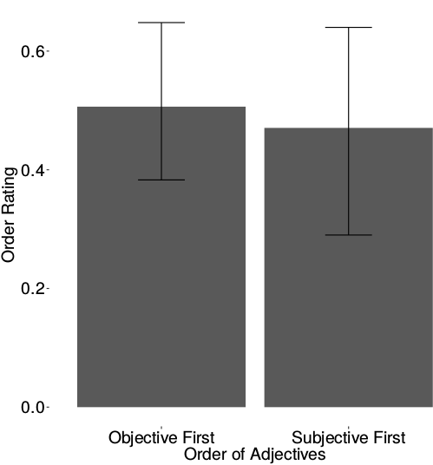
Alien-Alien
n.s.
the olm glab spaceship
the glab olm spaceship

Slide 52
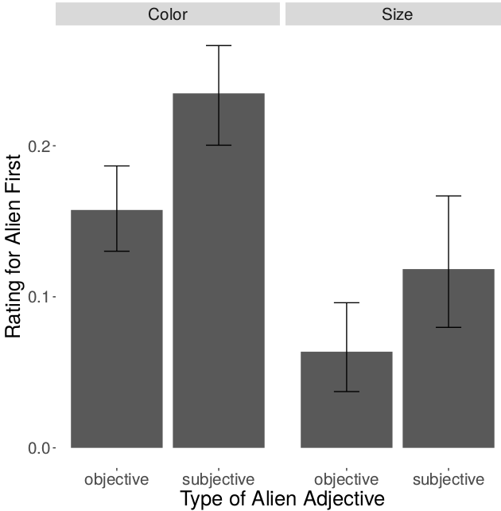
Alien-Color
p < 0.01
p < 0.05
the olm green spaceship
the glab green spaceship

Slide 53

Alien-Size
p < 0.05
the olm big spaceship
the glab big spaceship

Slide 54
Discussion
Participants’ preferences cannot be due to imitation of input:
Aliens never use two adjectives on a single trial before ratings block
Difference in meaning seems to be responsible
Participants apply linguistic generalization productively
Evidence that difference in subjectivity is responsible

Slide 55
Discussion
Why might subjectivity drive adjective ordering?
Proposal:
Objective adjective more useful in singling out referent due to agreement between speakers
Adjectives subject to progressive memory decay

Slide 56
Discussion: A Proposal
the
the
the
big
the
green
the
big
green
the
green
big
the
big
green
table
the
green
big
table
Placing objective adjective closer to noun helpful for reference resolution

Slide 57
Thanks!

Slide 58
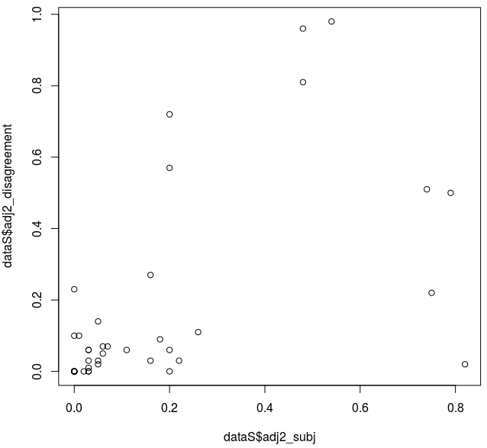
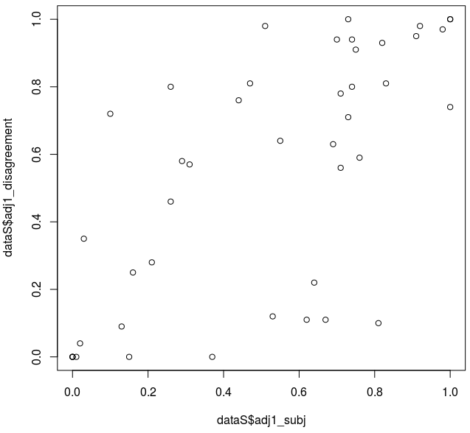
R = 0.59***
R = 0.68***
Faultless Disagreement
Faultless Disagreement
Subjectivity
Subjectivity

Slide 59
grirped | gwigs | joids | praife
brirk | trafes | heaned | juints
clou | milbed | slalps | crooch
fonns | anns | twawls | scorcs
spunes | toch | jaund | fict
spyck | rhould | brame | ceched
fruith | lised | irv | thomps
squalf | olm | snurts | cref
phoys | gelt | duilts | broff
jite | hafs | bamn | kolch
dwake | twell | spraived | muic
twad | lann | yafs | yunt
therv | physs | blef | plach
cuint | scrib | niege | trunce
ghoice | glab | preathe | shraste
Rastle et al. (2002)

Slide 60
clou | crooch | 1
crooch | duilts | 1
bamn | dwake | 1
brirk | dwake | 1
gelt | grirped | 1
cuint | irv | 1
duilts | jaund | 1
brirk | jite | 1
fict | jite | 1
fonns | jite | 1
fict | lann | 1
brirk | lised | 1
irv | plach | 1
fict | praife | 1
anns | preathe | 1
dwake | scorcs | 1
jite | scorcs | 1
phoys | scorcs | 1
fruith | slalps | 1
scrib | thomps | 1
squalf | thomps | 1
brame | toch | 1
cref | toch | 1
dwake | trafes | 1
therv | trafes | 1
slalps | trunce | 1
broff | twawls | 1
trafes | twell | 1
bamn | yafs | 1
thomps | yafs | 1
gelt | yunt | 1
kolch | niege | 1
grirped | olm | 1
joids | phoys | 1
crooch | plach | 1
plach | spraived | 1
duilts | spunes | 1
joids | spunes | 1
brirk | spyck | 1
rhould | spyck | 1
jaund | squalf | 1
praife | therv | 1
scorcs | therv | 1

